Slide 1
W02 – Secure Your Network with Just Enough Administration (JEA)
Jason Helmick
Pluralsight,
Level: Intermediate

Slide 2
This directly impacts the security of your company and its assets
This will prevent rogue administration
Reduce outages due to mistakes
Reduce Malware impact
Why This Is so Important

Slide 3
Role Based Access Control (RBAC) models
Reduce the number of Administrators
Limit and control what Administrators can perform
Understand exactly what Administrators are doing
JEA as a Security Model

Slide 4


Requirements for JEA
System 1
Endpoint
PowerShell
PS:> Get-Service –Name Spooler
Custom
Endpoint
PS:> Restart-Service –Name Spooler
Client
Client
Windows 10 with update 1511
Windows 8, 8.1
Windows 7*
Server
Windows Server 2016
Windows Server 2012,
2012 R2
Windows Server 2008R2*
Windows Management Framework 5 or above
* Support for virtual account not currently available

Slide 5
Management Roles
Active Directory
Help Desk
SQL/Exchange/Apps
IIS-Web

Slide 6
PowerShell Remoting
System 1
Endpoint
PowerShell
PS:> Get-Service –Name Spooler
PS:> Restart-Service –Name Spooler
Client
System 2
PowerShell
PS:> Get-Service –Name Spooler
PS:> Restart-Service –Name Spooler
System 3
PowerShell
PS:> Get-Service –Name Spooler
PS:> Restart-Service –Name Spooler

Slide 7
PowerShell Remoting with JEA
System 1
Endpoint
PowerShell
PS:> Get-Service –Name Spooler
Custom
Endpoint
PS:> Restart-Service –Name Spooler
Client
Session Configuration
Defines who and how
Specific to each machine
(.pssc) file
Role Capability
Defines what users can do
Can be shared across environment
(.psrc) file

Slide 8

JEA and Virtual Accounts
System 1
Endpoint
PowerShell
PS:> Get-Service –Name Spooler
Custom
Endpoint
PS:> Restart-Service –Name Spooler
Client
Virtual Accounts
One time privileged account
Runs under local Administrator
Can be configured for other accounts
Regular user account
Currently does not work for Windows 7 or Windows Server 2008R2

Slide 9
Working with the configuration files
Review of my setup
Working with files and cmdlets
Session Configuration
Role Capability
Creating using parameters
Scripting with Splatting for better maintenance
A graphical solution

Slide 10


Centralized Deployment with Automation
System 1
Custom
Endpoint
Module with Role capability file
.pssc
PS:> Get-Service –Name Spooler
PS:> Restart-Service –Name Spooler
Client
Deployment
Copy module to target
Copy session config to target
Register Endpoint
Run Registration Script

Slide 11
Prepare for the deployment
Create a registration script
Perform the deployment
Test the deployment

Slide 12
What Is Desired State Configuration?
Config
Document (mof)
System 1
DSC
Push/Pull model
Pull offers easy module copy/update
Need DSC Resource - JustEnouphAdminisation
Client/
Pull Server
System 2
System 3

Slide 13
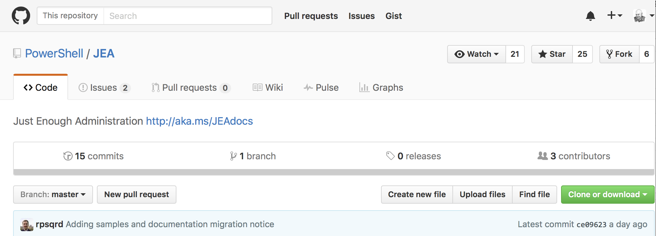
Deployment with DSC
Currently: Get the resource from GitHub
https://github.com/PowerShell/JEA
Do not use xJEA from PSGallery

Slide 14
Deploy the Resource module
Create the configuration document
Deploy configuration
Test the deployment

Slide 15
Reduce the number of excessive privileged accounts
Easy to create and manage endpoints
Decide exactly what an administrator can do
See what administrators are doing
Microsoft see’s benefits to JEA

Slide 16
Many administrators still use older GUI based applications
PowerShell proficiency is mandatory
Understanding the exact needs of an administrative role
Handling emergencies
Rolling out with educated administrators
Challenges

Slide 17
Identify the Role and the tasks that need to be enabled
Restrict those tasks as needed
Put them in a Role Capability file
Register the Session Configuration through automation or DSC
Test and correct as needed
The Steps

Slide 18
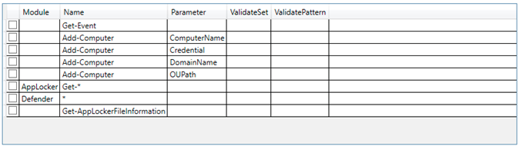
Identify the Role and tasks
The JEA Helper Tool
or your own .CSV

Slide 19
Work with administrators that have the needed PowerShell skills
Create Roles for the administrators
Create a “BreakTheGlass” endpoint for emergencies
Test and correct on a few ”Pilot” servers
Begin Roll-out to other servers
Performing Pilot to Production

Slide 20
Concept: Just In Time (JIT)
System 1
Endpoint
PowerShell
PS:> Get-Service –Name Spooler
Custom
Endpoint
PS:> Restart-Service –Name Spooler
Client
JEA Print Operators
Regular user account

Slide 21
Time—Bound membership
Windows Domains
Microsoft Privileged Access Management (PAM)
Based on Microsoft Identity Management (MIM)
Azure Privileged Identity Management
JIT/JEA
Scenario
Just In Time

Slide 22
THANK YOU FOR ATTENDING!!!
Follow me on Twitter! @theJasonHelmick
https://github.com/theJasonHelmick/TechMentor2017
Don’t forget evaluations!

